Slide 1
Introduction to Computer Organization
Welcome
Instructors:
Ajai Jain
Pranab Roy

Slide 2
Basics
Required Background
Programming (Native Compilation techniques)
Pick up C/C++ if not known already.
Knowledge of digital gates, flip-flops, latches, counters etc. Binary number system and operations
What will be covered?
Programming using Assembly Language Circuit descriptions in Bluespec Verilog (BSV) Computer Organization
2/16

Slide 3
Basics
Required Background
Programming (Native Compilation techniques)
Pick up C/C++ if not known already.
Knowledge of digital gates, flip-flops, latches, counters etc.
Binary number system and operations
What will be covered?
Programming using Assembly Language Circuit descriptions in Bluespec Verilog (BSV) Computer Organization
2/16

Slide 4
Basics
Required Background
Programming (Native Compilation techniques)
Pick up C/C++ if not known already.
Knowledge of digital gates, flip-flops, latches, counters etc. Binary number system and operations
What will be covered?
Programming using Assembly Language Circuit descriptions in Bluespec Verilog (BSV) Computer Organization
2/16

Slide 5
Basics
Required Background
Programming (Native Compilation techniques)
Pick up C/C++ if not known already.
Knowledge of digital gates, flip-flops, latches, counters etc. Binary number system and operations
What will be covered?
Programming using Assembly Language Circuit descriptions in Bluespec Verilog (BSV) Computer Organization
2/16

Slide 6
Basics
Required Background
Programming (Native Compilation techniques)
Pick up C/C++ if not known already.
Knowledge of digital gates, flip-flops, latches, counters etc. Binary number system and operations
What will be covered?
Programming using Assembly Language Circuit descriptions in Bluespec Verilog (BSV) Computer Organization
2/16

Slide 7
Basics
Required Background
Programming (Native Compilation techniques)
Pick up C/C++ if not known already.
Knowledge of digital gates, flip-flops, latches, counters etc. Binary number system and operations
What will be covered?
Programming using Assembly Language Circuit descriptions in VHDL
2/16

Slide 8
Lectures:
Wednesday, Thursday, Friday; 10:00 AM - 10:50 AM, EB-102
Labs:
Groups of 2-3 students
New language for design descriptions: VHDLAssembly language programming

Slide 9
Required Background (Let me know if you don’t have it)
Programming (Native Compilation techniques)
Pick up C/C++ if not known already.
Knowledge of digital gates, flip-flops, latches, counters etc ?
Binary number system and operations

Slide 10
Grading Policy Attendance: 5 Quizzes (announced or unannounced) : 10 Assignment : 10 Mid Semester Exam : 20 End Semester Exam : 30 Lab (Continuous Evaluation): 10 Lab (End Sem) : 15

Slide 11
Course Material:
No text books
Follow the lecture notes very closely
Reference Books
Assembly Language: Online notes http://asm.sourceforge.net/ http://chortle.ccsu.edu/AssemblyTutorial/index.html
Computer Organization:
Patterson, Hannessy: Computer Organization and Design Hamacher et.al.: Computer Organization
Tanenbaum: Structured Computer Organization Parhami: Computer Architecture
Stallings: Computer Organization and Architecture

Slide 12
Give feed back through out the semester Feel free to discuss anything with the instructor including criticism of instructor, TAs Participate in the discussion : No question is silly enough

Slide 13
Logistics
Keep checking the course web page for announcements. Do not be late for the class
Keep your cell phones switched off
7/16

Slide 14
DO NOT CHEAT
I follow zero tolerance policy.
Straight F for copying in assignment
I do not distinguish between the source and the destination nodes of the copy edge.
Names are also reported to authorities to be put in personal files.

Slide 15
Any Questions/Comments/Suggestions?

Slide 16
Review of Digital Circuits
Basic Gates
AND, OR, NAND, NOR, XOR, XNOR, NOT, BUF
Memory Elements Latch, Flip Flops Registers
Basic Circuits
10/16

Slide 17
Review of Digital Circuits
Basic Gates
AND, OR, NAND, NOR, XOR, XNOR, NOT, BUF
Memory Elements Latch, Flip Flops Registers
Basic Circuits
10/16

Slide 18
Review of Digital Circuits
Basic Gates
AND, OR, NAND, NOR, XOR, XNOR, NOT, BUF
Memory Elements Latch, Flip Flops Registers
Level Sensitive, Edge Triggered
Input output behaviour (Parallel or Serial): SISO (Delay Line), SIPO, PISO, PIPO
Basic Circuits
Multiplexers, Counters, ALU, Adders, Multipliers
10/16

Slide 19
Review of Digital Circuits
Basic Gates
AND, OR, NAND, NOR, XOR, XNOR, NOT, BUF
Memory Elements Latch, Flip Flops Registers
Level Sensitive, Edge Triggered
Input output behaviour (Parallel or Serial): SISO (Delay Line), SIPO, PISO, PIPO
Basic Circuits
Multiplexers, Counters, ALU, Adders, Multipliers
10/16

Slide 20
Review of Digital Circuits
Basic Gates
AND, OR, NAND, NOR, XOR, XNOR, NOT, BUF
Memory Elements Latch, Flip Flops Registers
Level Sensitive, Edge Triggered
Input output behaviour (Parallel or Serial): SISO (Delay Line), SIPO, PISO, PIPO
Basic Circuits
Multiplexers, Counters, ALU, Adders, Multipliers
10/16

Slide 21
Review of Digital Circuits
Basic Gates
AND, OR, NAND, NOR, XOR, XNOR, NOT, BUF
Memory Elements Latch, Flip Flops Registers
Level Sensitive, Edge Triggered
Input output behaviour (Parallel or Serial): SISO (Delay Line), SIPO, PISO, PIPO
Basic Circuits
Multiplexers, Counters, ALU, Adders, Multipliers
10/16

Slide 22
Review of Digital Circuits
Basic Gates
AND, OR, NAND, NOR, XOR, XNOR, NOT, BUF
Memory Elements Latch, Flip Flops Registers
Level Sensitive, Edge Triggered
Input output behaviour (Parallel or Serial): SISO (Delay Line), SIPO, PISO, PIPO
Basic Circuits
Multiplexers, Counters, ALU, Adders, Multipliers
10/16

Slide 23
Review of Digital Circuits
Basic Gates
AND, OR, NAND, NOR, XOR, XNOR, NOT, BUF
Memory Elements Latch, Flip Flops Registers
Level Sensitive, Edge Triggered
Input output behaviour (Parallel or Serial): SISO (Delay Line), SIPO, PISO, PIPO
Basic Circuits
Multiplexers, Counters, ALU, Adders, Multipliers
10/16

Slide 24
Review of Digital Circuits
Basic Gates
AND, OR, NAND, NOR, XOR, XNOR, NOT, BUF
Memory Elements Latch, Flip Flops Registers
Level Sensitive, Edge Triggered
Input output behaviour (Parallel or Serial): SISO (Delay Line), SIPO, PISO, PIPO
Basic Circuits
Multiplexers, Counters, ALU, Adders, Multipliers
10/16

Slide 25
Transistor: Building Block of Computers
Microprocessors contain millions of transistors
Intel Pentium 4 (2000): 48 million
IBM PowerPC 750FX (2002): 38 million
IBM/Apple PowerPC G5 (2003): 58 million
Logically, each transistor acts as a switch
Combined to implement logic functions
AND, OR, NOT
Combined to build higher-level structures
Adder, multiplexer, decoder, register, …
Combined to build processor
LC-3
Notes:
Intel and Pentium are trademarks of Intel Corporation. IBM and PowerPC are trademarks of International Business Machines Corporation. Apple is a trademark of Apple Computer, Inc.

Slide 26
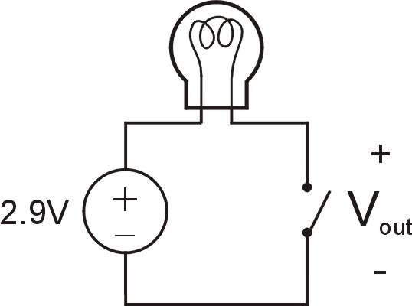
Simple Switch Circuit
Switch open:
No current through circuit
Light is off
V_{out} is +2.9V
Switch closed:
Short circuit across switch
Current flows
Light is on
V_{out} is 0V
Switch-based circuits can easily represent two states:
on/off, open/closed, voltage/no voltage.

Slide 27

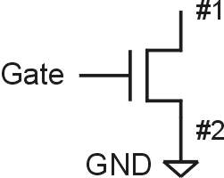
n-type MOS Transistor
MOS = Metal Oxide Semiconductor
two types: n-type and p-type
n-type
when Gate has positive voltage, short circuit between #1 and #2 (switch closed)
when Gate has zero voltage, open circuit between #1 and #2 (switch open)
Gate = 1
Gate = 0
Terminal #2 must be
connected to GND (0V).

Slide 28
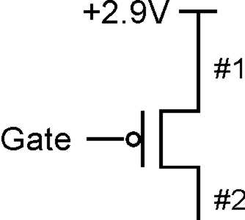
p-type MOS Transistor
p-type is complementary to n-type
when Gate has positive voltage, open circuit between #1 and #2 (switch open)
when Gate has zero voltage, short circuit between #1 and #2 (switch closed)
Gate = 1
Gate = 0
Terminal #1 must be
connected to +2.9V.

Slide 29
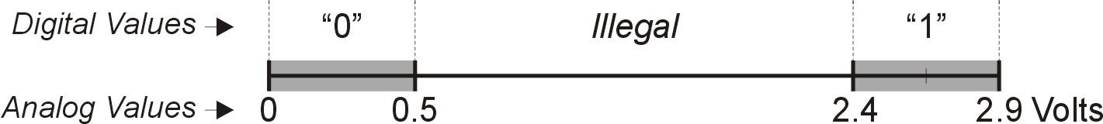
Logic Gates
Use switch behavior of MOS transistors to implement logical functions: AND, OR, NOT.
Digital symbols:
recall that we assign a range of analog voltages to each digital (logic) symbol
assignment of voltage ranges depends on electrical properties of transistors being used
typical values for "1": +5V, +3.3V, +2.9V
from now on we'll use +2.9V

Slide 30
CMOS Circuit
Complementary MOS
Uses both n-type and p-type MOS transistors
p-type
Attached to + voltage
Pulls output voltage UP when input is zero
n-type
Attached to GND
Pulls output voltage DOWN when input is one
For all inputs, make sure that output is either connected to GND or to +, but not both!

Slide 31
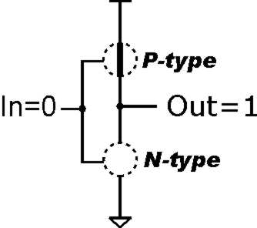
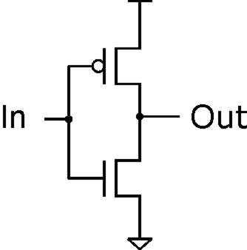
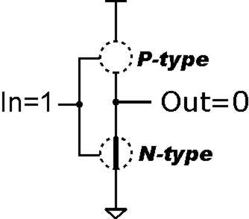
Inverter (NOT Gate)
Truth table
In | Out
0 V | 2.9 V
2.9 V | 0 V
In | Out
0 | 1
1 | 0

Slide 32
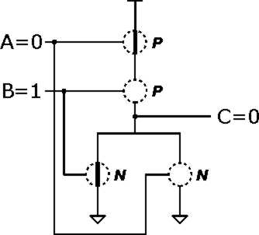
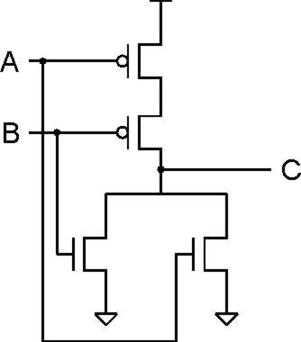
NOR Gate
A | B | C
0 | 0 | 1
0 | 1 | 0
1 | 0 | 0
1 | 1 | 0
Note: Serial structure on top, parallel on bottom.

Slide 33
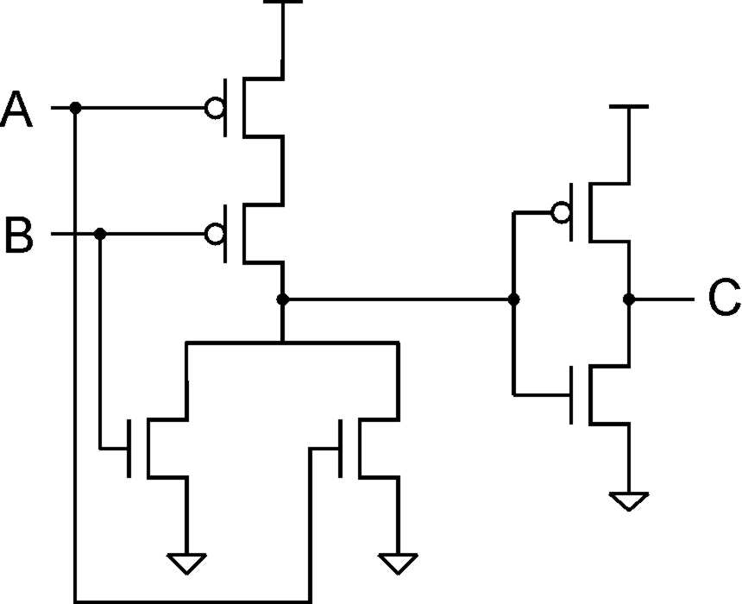
OR Gate
A | B | C
0 | 0 | 0
0 | 1 | 1
1 | 0 | 1
1 | 1 | 1
Add inverter to NOR.

Slide 34
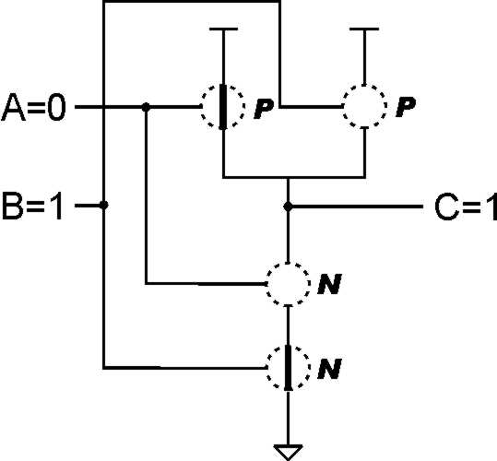
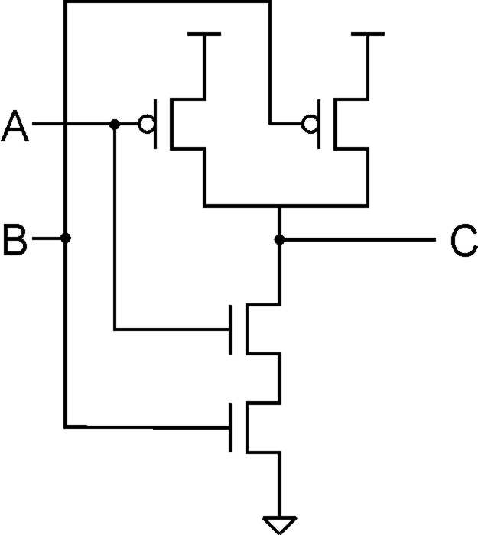
NAND Gate (AND-NOT)
A | B | C
0 | 0 | 1
0 | 1 | 1
1 | 0 | 1
1 | 1 | 0
Note: Parallel structure on top, serial on bottom.

Slide 35
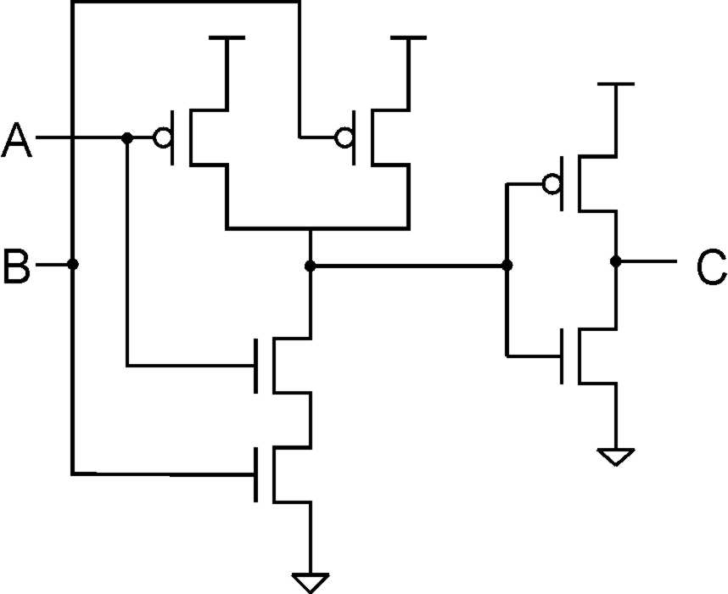
AND Gate
A | B | C
0 | 0 | 0
0 | 1 | 0
1 | 0 | 0
1 | 1 | 1
Add inverter to NAND.

Slide 36
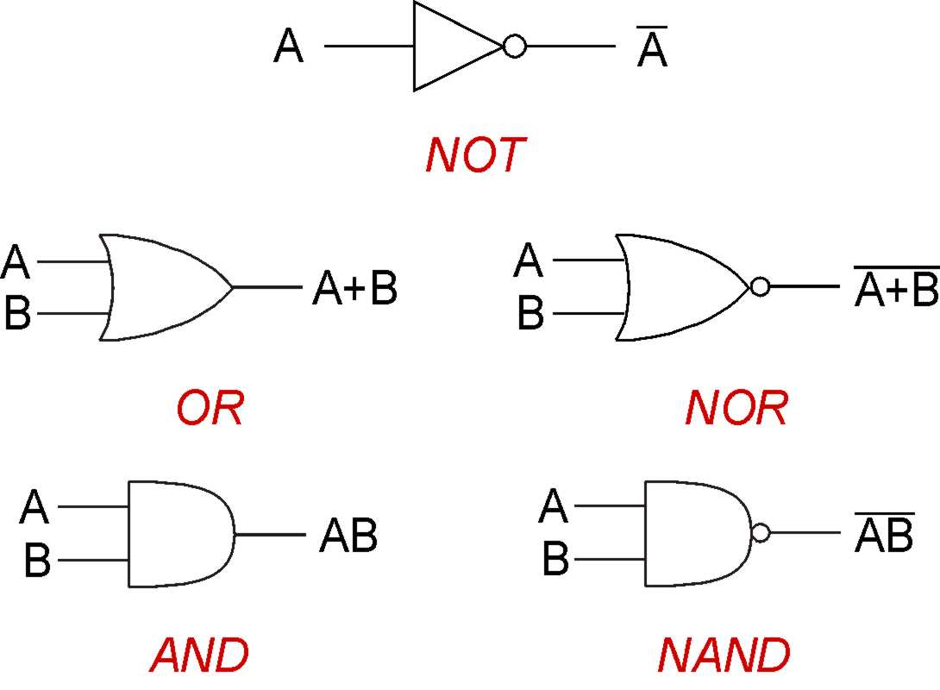
Basic Logic Gates

Slide 37
Combinatorial Gates
always @(a or b) y = a & b;
OR
assign y = a & b;

Slide 38
Memory Elements
Latches
always @( LE or D )
if (LE == 1) Q = D;
Flip Flops
always ( posedge CLK ) Q = D;
Latches are level sensitive while flip flops are edge triggered.
12/16

Slide 39
Memory Elements
Latches
always @( LE or D )
if (LE == 1) Q = D;
Flip Flops
always ( posedge CLK ) Q = D;
Latches are level sensitive while flip flops are edge triggered.
12/16

Slide 40
Memory Elements
Latches
always @( LE or D )
if (LE == 1) Q = D;
Flip Flops
always ( posedge CLK ) Q = D;
Latches are level sensitive while flip flops are edge triggered.
12/16

Slide 41
Memory Elements
Latches
always @( LE or D )
if (LE == 1) Q = D;
Flip Flops
always ( posedge CLK ) Q = D;
Latches are level sensitive while flip flops are edge triggered.
12/16

Slide 42
A Computer
Computer is a “machine”
As long as power is supplied, processor keeps executing instructions
Stored program model
Sequential order of execution
Memory: Program and data storage Disk: File storage (passive data storage)
13/16

Slide 43
A Computer
Computer is a “machine”
As long as power is supplied, processor keeps executing instructions
Stored program model Sequential order of execution
Memory: Program and data storage Disk: File storage (passive data storage)
13/16

Slide 44
A Computer
Computer is a “machine”
As long as power is supplied, processor keeps executing instructions
Stored program model
Sequential order of execution
Memory: Program and data storage
Disk: File storage (passive data storage)
13/16

Slide 45
A Computer
Computer is a “machine”
As long as power is supplied, processor keeps executing instructions
Stored program model Sequential order of execution
Memory: Program and data storage Disk: File storage (passive data storage)
13/16

Slide 46
A Computer
Computer is a “machine”
As long as power is supplied, processor keeps executing instructions
Stored program model Sequential order of execution
Memory: Program and data storage
Disk: File storage (passive data storage)
13/16

Slide 47
A Computer
Computer is a “machine”
As long as power is supplied, processor keeps executing instructions
Stored program model Sequential order of execution
Memory: Program and data storage Disk: File storage (passive data storage)
13/16

Slide 48
Computer is a machine
CPU
I/O
MEMORY
14/16

Slide 49
The machine is electronic
CPU
I/O
MEMORY
14/16

Slide 50
Fetch-Execute-Store Model
Processor reads an instruction from memory
Instruction:
A sequence of bits, understood and operated upon by processor
Processor interprets these bits and operates on data
Stored in internal registers or in memory
Result of the execution is stored in memory/registers. Processor continues fetching the next instruction. Program:
Collection of instructions that are fetched and executed one after another
15/16

Slide 51
Fetch-Execute-Store Model
Processor reads an instruction from memory Instruction:
A sequence of bits, understood and operated upon by processor
Processor interprets these bits and operates on data
Stored in internal registers or in memory
Result of the execution is stored in memory/registers. Processor continues fetching the next instruction. Program:
Collection of instructions that are fetched and executed one after another
15/16

Slide 52
Fetch-Execute-Store Model
Processor reads an instruction from memory Instruction:
A sequence of bits, understood and operated upon by processor
Processor interprets these bits and operates on data
Stored in internal registers or in memory
Result of the execution is stored in memory/registers. Processor continues fetching the next instruction. Program:
Collection of instructions that are fetched and executed one after another
15/16

Slide 53
Fetch-Execute-Store Model
Processor reads an instruction from memory Instruction:
A sequence of bits, understood and operated upon by processor
Processor interprets these bits and operates on data
Stored in internal registers or in memory
Result of the execution is stored in memory/registers. Processor continues fetching the next instruction. Program:
Collection of instructions that are fetched and executed one after another
15/16

Slide 54
Fetch-Execute-Store Model
Processor reads an instruction from memory Instruction:
A sequence of bits, understood and operated upon by processor
Processor interprets these bits and operates on data
Stored in internal registers or in memory
Result of the execution is stored in memory/registers. Processor continues fetching the next instruction. Program:
Collection of instructions that are fetched and executed one after another
15/16

Slide 55
Fetch-Execute-Store Model
Processor reads an instruction from memory Instruction:
A sequence of bits, understood and operated upon by processor
Processor interprets these bits and operates on data
Stored in internal registers or in memory
Result of the execution is stored in memory/registers. Processor continues fetching the next instruction. Program:
Collection of instructions that are fetched and executed one after another
15/16

Slide 56
Fetch-Execute-Store Model
Processor reads an instruction from memory Instruction:
A sequence of bits, understood and operated upon by processor
Processor interprets these bits and operates on data
Stored in internal registers or in memory
Result of the execution is stored in memory/registers. Processor continues fetching the next instruction. Program:
Collection of instructions that are fetched and executed one after another
15/16

Slide 57
Fetch-Execute-Store Model
Processor reads an instruction from memory Instruction:
A sequence of bits, understood and operated upon by processor
Processor interprets these bits and operates on data
Stored in internal registers or in memory
Result of the execution is stored in memory/registers. Processor continues fetching the next instruction. Program:
Collection of instructions that are fetched and executed one after another
15/16

Slide 58
Fetch-Execute-Store Model
Processor reads an instruction from memory Instruction:
A sequence of bits, understood and operated upon by processor
Processor interprets these bits and operates on data
Stored in internal registers or in memory
Result of the execution is stored in memory/registers. Processor continues fetching the next instruction. Program:
Collection of instructions that are fetched and executed one after another
15/16

Slide 59
Fetch-Execute-Store Model
Processor takes program only as a sequence of bits
Machine Language
We understand programs in various forms
Assembly language: One to one correspondence with the machine language
High level languages:
Programs for Virtual machine:
16/16

Slide 60
Fetch-Execute-Store Model
Processor takes program only as a sequence of bits
Machine Language
We understand programs in various forms
Assembly language: One to one correspondence with the machine language
High level languages:
Programs for Virtual machine:
16/16

Slide 61
Fetch-Execute-Store Model
Processor takes program only as a sequence of bits
Machine Language
We understand programs in various forms
Assembly language: One to one correspondence with the machine language
High level languages:
Translators are needed to convert to machine language (compilers)
Programs for Virtual machine:
Languages such as Java, compile code to a virtual machine which is then interpreted by a tool.
16/16

Slide 62
Fetch-Execute-Store Model
Processor takes program only as a sequence of bits
Machine Language
We understand programs in various forms
Assembly language: One to one correspondence with the machine language
High level languages:
Translators are needed to convert to machine language (compilers)
Programs for Virtual machine:
Languages such as Java, compile code to a virtual machine which is then interpreted by a tool.
16/16

Slide 63
Fetch-Execute-Store Model
Processor takes program only as a sequence of bits
Machine Language
We understand programs in various forms
Assembly language: One to one correspondence with the machine language
High level languages:
Translators are needed to convert to machine language (compilers)
Programs for Virtual machine:
Languages such as Java, compile code to a virtual machine which is then interpreted by a tool.
16/16

Slide 64
Fetch-Execute-Store Model
Processor takes program only as a sequence of bits
Machine Language
We understand programs in various forms
Assembly language: One to one correspondence with the machine language
High level languages:
Translators are needed to convert to machine language (compilers)
Programs for Virtual machine:
Languages such as Java, compile code to a virtual machine which is then interpreted by a tool.
16/16

Slide 65
Fetch-Execute-Store Model
Processor takes program only as a sequence of bits
Machine Language
We understand programs in various forms
Assembly language: One to one correspondence with the machine language
High level languages:
Translators are needed to convert to machine language (compilers)
Programs for Virtual machine:
Languages such as Java, compile code to a virtual machine which is then interpreted by a tool.
16/16

Slide 66
Fetch-Execute-Store Model
Processor takes program only as a sequence of bits
Machine Language
We understand programs in various forms
Assembly language: One to one correspondence with the machine language
High level languages:
Translators are needed to convert to machine language (compilers)
Programs for Virtual machine:
Languages such as Java, compile code to a virtual machine which is then interpreted by a tool.
16/16

